Slide 1
Simpson’s Paradox
Observed relationship in data may be influenced by the presence of other confounding factors (hidden variables)
Hidden variables may cause the observed relationship to disappear or reverse its direction!
Proper measures are required to avoid generating spurious patterns

Slide 2
Simpson’s Paradox
Recovery rate from Covid
Hospital A: 80%
Hospital B: 90%
Which hospital is better?

Slide 3
Simpson’s Paradox
Recovery rate from Covid
Hospital A: 80%
Hospital B: 90%
Which hospital is better?
Covid recovery rate on older population
Hospital A: 50%
Hospital B: 30%
Covid recovery rate on younger population
Hospital A: 99%
Hospital B: 98%
Notes:
Observational
Expermental study

Slide 4
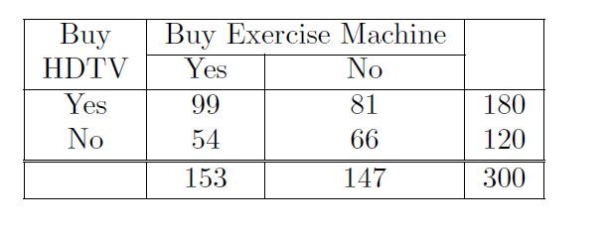
Simpson’s Paradox
Notes:
{HDTV=Yes}
−→ {Exercise machine=Yes}
{HDTV=No} −→ {Exercise machine=Yes}
99/180 = 55%
54/120 = 45%.

Slide 5
Simpson’s Paradox
Together, these rules suggest that customers who buy high-definition televisions are more likely to buy exercise machines than those who do not buy high-definition televisions

Slide 6
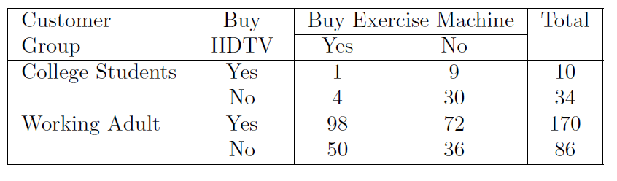
Simpson’s Paradox-Continued
Notes:
However, a deeper analysis reveals that the sales of these items depend
on whether the customer is a college student or a working adult. Table 6.20
summarizes the relationship between the sale of HDTVs and exercise machines
among college students and working adults. Notice that the support counts
given in the table for college students and working adults sum up to the frequencies
shown in Table 6.19. Furthermore, there are more working adults
c
{HDTV=Yes} −→ {Exercise machine=Yes}
= 1/10 = 10%,
c
{HDTV=No} −→ {Exercise machine=Yes}
= 4/34 = 11.8%,
c
{HDTV=Yes} −→ {Exercise machine=Yes}
= 98/170 = 57.7%,
c
{HDTV=No} −→ {Exercise machine=Yes}
= 50/86 = 58.1%.

Slide 7
Simpson’s Paradox
The rules suggest that, for each group customers who do not buy high-definition televisions are more likely to buy exercise machines, which contradicts the previous conclusion when data from the two customer groups are pooled together.
The reversal in the direction of association is known as Simpson’s paradox

Slide 8
Simpson’s Paradox
Notice that most customers who buy HDTVs are working adults. Working adults are also the largest group of customers who buy exercise machines. Because nearly 85% of the customers are working adults, the observed relationship between HDTV and exercise machine turns out to be stronger in the combined data than what it would have been if the data is stratified.
The reversal in the direction of association is known as Simpson’s paradox

Slide 9
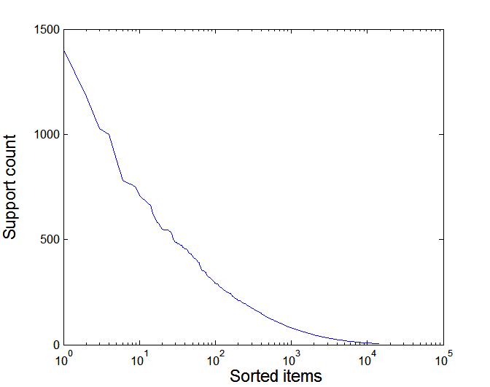
Effect of Support Distribution on Association Mining
Few items with high support
Many items with low support
Support distribution of a retail data set
Rank of item (in log scale)
Many real data sets have skewed support distribution

Slide 10
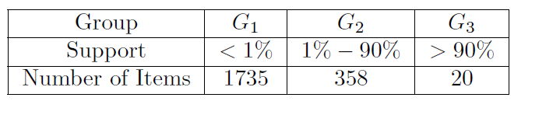
Example
Many real data sets have skewed support distribution

Slide 11
Effect of Support Distribution
Difficult to set the appropriate minsup threshold
If minsup is too high, we could miss itemsets involving interesting rare items (e.g., {caviar, vodka})
If minsup is too low, it is computationally expensive and the number of itemsets is very large

Slide 12
Cross-Support Patterns
First, the computational and memory requirements of existing association analysis algorithms increase considerably with low support thresholds.
Second, the number of extracted patterns also increases substantially with low support thresholds.
Third, we may extract many spurious patterns that relate a high-frequency item such as milk to a low-frequency item such as caviar.
Such patterns, which are called cross-support patterns, are likely to be spurious because their correlations tend to be weak

Slide 13
Cross-Support Patterns
A cross-support pattern involves items with varying degree of support
Example: {caviar,milk}
caviar
milk

Slide 14
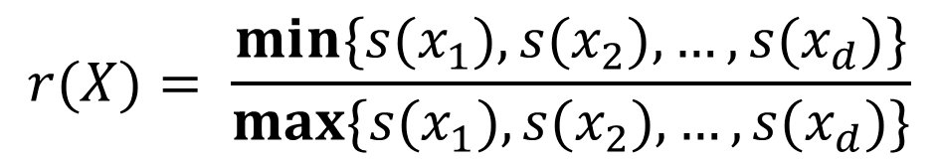
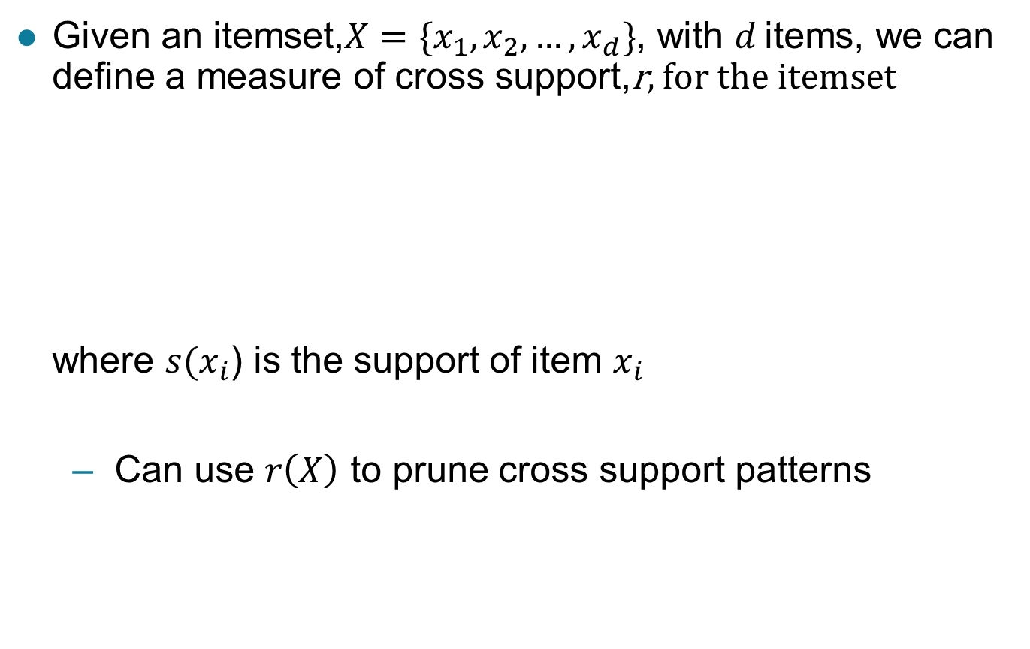
A Measure of Cross Support
$$r(X)= \frac{min\{s(x_{1}),s(x_{2}), …,s(x_{d})\}}{max\{s(x_{1}),s(x_{2}), …,s(x_{d})\}}$$
Given an itemset,$X=\{x_{1},x_{2},…,x_{d}\}$, with $d$ items, we can define a measure of cross support,r, for the itemset where $s(x_{i}$) is the support of item $x_{i}$
Can use $r\left(X\right)$ to prune cross support patterns

Slide 15
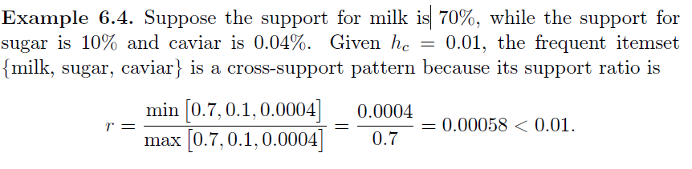
Example
Notes:
user-specified threshold

